Slide 1

New Referee Clinic

Slide 2
OSI Officiating Philosophy
As officials, we help conduct swim meets so that fair and equitable conditions of competition are maintained and uniformity in the sport is promoted so that no swimmer has an unfair advantage over another.
Officials demonstrate impartiality and professionalism on deck through uniform, posture, facial expressions, language and interactions with others on deck.
When you go out onto the deck you want to be recognized by the coaches, athletes and spectators, as a professional official; you want them to respect you and understand that whatever you do it is in the best interest of the athlete.
The success of every meet depends on the official’s integrity, knowledge, concern and regard for the competitive interest of the swimmer.

Slide 3
What does that mean?
One set of rules applies to all swimmers, regardless of age or skill level.* The rules determine what is or isn’t allowed.
Ugly swims can be legal
We observe swims, we do not inspect.
Do not infer or extrapolate from observations.
Swimmers always get the benefit of the doubt!
* Swimmers with disabilities are accommodated.

Slide 4
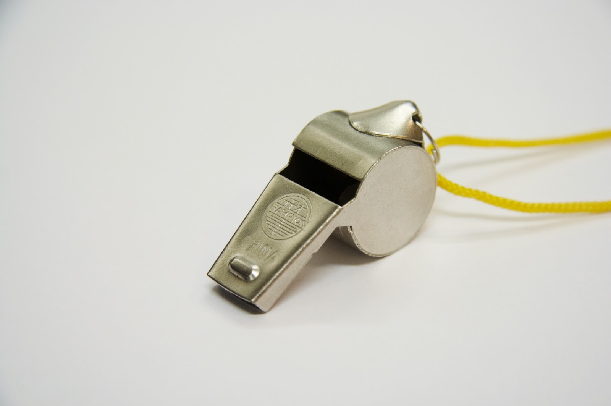
Agenda
Meet types or levels
Roles of a Referee
Rules Pertaining to the Referee
Process
Meet Planning
Pre-Session
At the Meet
After the Meet
Reference Material
Training Opportunities

Slide 5
Levels of Meets
LSC
Regional
LSC Championships
Sectional Championships
Zone Championships
Futures Championships
Pro Series
National Championships
International Championships
Regardless of level…It’s a Swim Meet! Most of the procedures and issues are the same. Some of the differences can be in staffing, process detail and protocol.
All meets deserve your full attention and total quality effort.

Slide 6
Three Refereeing Roles
Meet Referee
The head official at the meet, Team Leader
Overall responsibility for the conduct of the meet
Admin Referee
Works with, supervises and directs the ‘dry-deck’: Timing judges, AO, Scratches, Deck Seeding, etc.
Deck Referee
Supervises and directs the ‘wet-deck’: Starter, CJs, S&T, Timers.
Runs the session as assigned by Meet Ref.
All three: Ensure fair and equitable competition!

Slide 7
Meet Referee
The head official at the meet – the leader of the TEAM.
Has overall responsibility for the conduct of the meet.
Work with the Meet Director in organizing and setting up the meet and preparing the meet information.
Request to be copied on all key communication.
Confirm key roles at the meet – ie announcer, officials, head timers, bull pen monitors, etc.
Be familiar with the venue – Safety is a key consideration.
Work with AO or Admin Ref in overseeing entries and timelines.
Select Meet Jury (championship meets)
Recruit and oversee officials
Hold Official’s and Coach’s meetings
Review procedures and protocols.
Be available to Coaches, Athletes and Officials
Oversee meet and attend to issues or problems
Be flexible and willing to make adjustments as needed
Follow up with responsibilities after the meet.

Slide 8
Administrative Referee
Generally a Championship format function.
Assist Meet Referee and Meet Director in pre-meet planning.
At the Meet:
Supervises the Console Operator, Timing Judge, Recorder, and Clerk of Course
Make decisions regarding fair application of: Entries Procedures, Check-in Procedures, Scratch /No-show Procedures
Review Seeding and Heat Sheet Preparation
Approve Timing Adjustments
Process DQs (after Deck Ref approval)
Review Results Preparation/Publication
Coordinate Swim-Offs
Review Relay Seeding and Results
Coordinate Time Trials (or a Time Trials Ref will be appointed)

Slide 9
Deck Referee
Supervise Starters and Stroke & Turn Judges
Supervise deck officials and be aware and supportive of their needs. Be willing to step in as needed.
Control the flow of the meet
The timeline is the pre-meet plan: Do not rush swimmer’s starts because you are behind on the timeline.
Swimmers will respond to your whistle pace.
Review/Approve DQs
Inquire to the extent practical about calls. At minimum, spot-check: “What did you observe?”
First line of question or appeal from the coaches

Slide 10
Deck Referee
Responding to coach inquiries regarding calls
Coach’s job is to be an advocate for the athletes. They want to be heard.
Best practice for Deck Referees in response to coach questioning.
Be an active listener.
Let the coach know that you are happy to investigate.
“Let me look into it, and I’ll get back to you”
Let the coach go back to coaching, and ask where you can find them.
Get more information about call from S & T / CJ
Follow up with coach & explain your decision to uphold or overturn call.

Slide 11
Deck Referee
Missed Swim
Swimmer or coach approaches DR after missing an event.
Determine procedure for missed swim as stated at coach’s meeting or in Meet Information for this meet.
If accommodations are allowed
Find any reasonable way to fit the swim in: Later no-show, same-distance / event opening, etc.
Remember: What you do for one swimmer must apply to all swimmers.
Championships: In general, no-show rules applies rule per Meet Information. At DR’s discretion, a DQ for Delay of Meet may be issued.

Slide 12
Description of a Good Referee
C-a-l-m-m-m
Aware
Delegates
Knowledgeable
Communicates
Experienced
Encourages others
Friendly
Confident
Team Player
Professional
Proactive
Welcomes input & questions
Above all: Is Fair!

Slide 13
Referee Rules
Article 102 – Conduct and Officiating of All Swimming Competition
* 102.11 – REFEREE. (Abbreviated -see rule book for full version)
.1 Shall have full authority over all officials and shall assign and instruct them; shall enforce all applicable rules and shall decide all questions relating to the actual conduct of the meet, the final settlement of which is not otherwise assigned by said rules; can overrule any meet official on a point of rule interpretation, or on a judgment decision pertaining to an action which the Referee has personally observed.
.2 Has the authority to disqualify a swimmer(s) for any violation of the rules that the Referee personally observes and, except for false starts, shall at the same time raise one hand over- head. If the Referee does not make such a signal there shall be no disqualification.
.5 Shall give a decision on any point where the opinions of the judges differ; and shall have authority to intercede in a competition at any stage, to ensure that the appropriate racing conditions are observed.

Slide 14
Referee Rules - Abbreviated - continued
102.22 – PROTESTS
.1 – "Protests against the judgment decisions of starters, stroke, turn, place and relay take-off judges can only be considered by the Referee and the Referee’s decision shall be final.
.2 - For consideration of all other protests lodged at the meet, the Referee may appoint a meet jury. The jury shall consist of not fewer than three (3) and not more than five (5) persons, at least one of whom shall be a coach and one an athlete.
102 .7 – POSTPONEMENTS AND CHANGES IN PROGRAM
1 The order of events, as stated in the meet announcement, shall not be changed. The announced arrangement of heats in any event shall not be added to or altered, except by the authority of the Referee, to the extent of consolidating the heats.
.2 At the Meet Referee’s discretion, events may be combined by age, gender, distance, and/or stroke provided there is at least one empty lane between such combined events. The Referee may waive the empty lane requirement with the concurrence of the coaches of the affected swimmers.

Slide 15
Rules Modifications
The Referee has “the authority to modify the rules for the swimmer with a disability.” (105.1.1)
Determine if the requested modifications are appropriate and can be met. (105.1.2B)
Changes may include (but are not limited to): Starting position, lane reassignment, personal assistant.
Not allowed: Aids to buoyancy and speed.
BOTTOM LINE: Review disability rules before every meet, ask coaches if any swimmers may need accommodation. Make the necessary modifications to allow swimmers to compete!

Slide 16
Meet Planning (Meet Referee)
The Meet Referee is generally selected by the Meet Host
Work with the Meet Director to create the Meet Information
Meet Information is the guidebook for the Meet: Facility details, entry process, entry deadlines (open and close), penalties, schedule, etc.
Decisions made live at a meet must conform with the Meet Information unless coaches approve.
Review before cutting-and-pasting last year’s version.
Avoid absolutes: “Administrative break maybe added at MR discretion”

Slide 17
Meet Planning (Meet Referee)
Deck-seeded events (usually 400+ distance) Will run most smoothly if planned for later in the session.
Set workable entry deadlines to avoid paperwork delays.
Specify no-show and scratch procedure with AO
Work with the Meet Director to determine a timeline appropriate to the level of meet and when it occurs.
The timeline should be a reasonable plan. Once a meet is underway, it will change based on equipment, weather, swimmer preparedness to race and unexpected events. Expect the unexpected!

Slide 18
Meet Planning (Meet Referee)
“The Four-Hour Rule”: Rule 205.3.1F was adopted…to ensure that swimming would be competitive with other youth sports, namely baseball and soccer, insofar as time commitment for both athletes and parents was concerned. It was not in the best interest of our sport for developmental athletes to be at a pool all day or for the entire weekend to the exclusion of other family interests, particularly when other athletic activities could be completed in a far more reasonable time.
(from official USA Swimming Rules Interpretation, emphasis added)

Slide 19
Meet Planning (Meet Referee)
Practical application of the Four-Hour Rule:
This is a guideline for all sessions, not just 12U.
Work with the Meet Director and Host with a bias toward more, shorter sessions rather than fewer, longer ones.
When reviewing entries, do not accept unrealistic heat intervals, e.g. 10 secs for 12U.
Senior A meet: 25 seconds, 12U meet: 30 to 45 seconds
Longer heat intervals are appropriate for younger, and novice swimmers.

Slide 20
Meet Planning (Meet Referee)
Recruit and assign officials for every meet
Be proactive! Actively recruit an assistant Ref/Deck Ref, Starter(s), CJs and a few key S&Ts rather than leaving the deck to “whoever shows up”.
Mix experienced officials with newer ones.
When chief judges are planned, the officials meetings are typically delegated to them
Supervise Officials Team

Slide 21
Meet Planning (Meet Referee) Chief Judges
It is expected that CJs are assigned at Championship meets.
Add CJs to the team when possible, even with small crews.
Recruit ahead or decide the day-of based on attendance.
Always keep S & T rotations in mind if adding CJs.
Use to validate calls and support Deck Referees.
It is acceptable to have CJs without radios.

Slide 22
Meet Planning (Meet Referee) Setting the Deck
This can be delegated to a CJ or DR
Fill the Stroke and Turn positions first.
Staff the deck for the meet needs. Consider the number of lanes, LC vs SC, weather, facility layout, etc.
Priority always should be welfare of S&Ts (breaks, sun/shade) and observation of highest-action areas.
Sufficient breaks should be allowed for Officials to get to hospitality and manage time on warm decks.
When it is a thin crew, be creative:
Starter can double as S&T at edge lane.
Consider areas that have the most action. It’s OK to have more officials at Start/Finish than Turn if short.

Slide 23
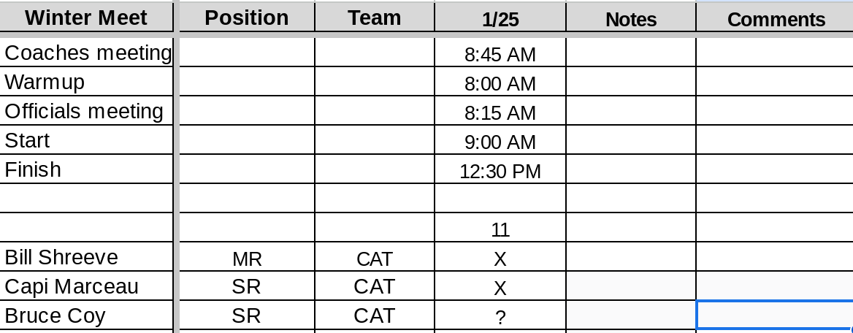
Official Planning List

Slide 24
When You Arrive
Check in with Meet Director, Clerk of Course, resolve any pending questions/issues.
Check in with Facility Staff. Start/Finish times, emergency protocols, possible external issues (e.g. weather). What are the water & air temps?
Inspect Venue: Where are First Aid kits, backboards, exits? Any deck obstacles to clear? Use checklist!
Are Safety Marshalls in place?
Talk with Announcer about timelines, announcements, Anthem, etc.

Slide 25
The Officials Meeting
Official’s meetings are mandatory. It is recommended to begin Official’s meeting 1 hour prior to start of session.
This meeting should be a relaxed, team-building and educational opportunity.
Leave your team time for post-meeting conversation, hydration, bathroom break.
Stroke Briefings:
Tailor the briefing to the experience level of the team. Early season or many trainees may merit more detail.
Can be fun: Question games, Dr. Seuss, etc.
Beware of “rule of the day.”
Big Trap: Rote reading/recitation of rules, protocols and meet info, too short.

Slide 26
The Officials Meeting
Key items to cover:
Introductions
Timeline for session.
MAAPP requirements - Bathrooms for officials
Stroke, jurisdiction, deck protocol, rotation/breaks.
Trainer/Trainee assignments and expectations.
Any problems/issues. What did someone do well?
Announcements
Thank you! – e.g. hospitality, Meet Director, others

Slide 27
The Coaches Meeting
Start of EVERY meet, typically 10 minutes
Cover highlights, what is different at the meet or venue
MAAPP requirements
Your approach to the meet, e.g. missed swims
Protected/unprotect swims
Tape
Probable contingencies for likely issues, e.g. weather
Meet deadlines/timelines
Scratch/deck seeding/etc. processes
Disability accommodations?
Necessary changes from Meet Info? Need approval.
Warm up/warm down procedures
Anything else that should be flagged or addressed
Referee Notebook
Review Rules and Policies

Slide 28
During the Meet
Supervise Warm-Ups
USA Swimming/OSI Swimming Policy
No marshals or invigilators = no swimming!
Walk the Deck
Talk with Coaches, swimmers, and officials
Sense problems, build respect and ‘team’
Work with Admin Referee / Deck Referee
DELEGATE (authority, not responsibility), SUPPORT
Work with ‘Wet-Deck’ Officials
Monitor position, alertness, calls
Work with ‘Dry-Deck’ Officials
Monitor flow of data, decisions, timeliness of results

Slide 29
DQ SLIPS
Name, Heat & Lane should be checked at each step.
Do not reject calls for incorrect slips. This is a clerical issue…have slips rewritten.
Steps of review: CJ, then Deck Ref, then ET, then AO, and then Meet Ref. Check, check and re-check!
Don’t let DQ slips take on a life of their own. The layers exist to protect the swimmers’ times.

Slide 30
In-Meet Tips
Work with Coaches, Swimmers, Parents
Keep them informed
LISTEN, answer questions, get additional information
Take conflict off deck
Work with Announcer
Discuss responsibilities and expectations, coordinate announcements
Work with Chief Timer
Starter role: Timer briefing (MAAPP), esp. early in season
Work with the Meet Director
Control the venue
Solve problems
Decide Protests
Conduct Meet Juries. (Appoint at beginning of meet.)

Slide 31
In-Meet Tips
Be careful of setting precedents with early decisions
Rather than answer immediately respond with “I’ll get back to you.” Give yourself time to think through implications.
Communicate decisions to DRs and CJs.
Don’t be afraid to ask questions or correct mistakes
May keep a DQ log. A good tool to see how the S&T team is performing; reveals over- and under-officiating.
Teach, provide feedback.

Slide 32
After the Meet
Thank and excuse the officials.
Thank the timers and other support staff
Follow up with Dry Side officials
Follow up with Meet Director
Complete any required paperwork
Enter Official’s sessions and activities into the OTS
Conduct Self-Evaluation

Slide 33
Reference Material
OSI Web Site Officials Page
USA Swimming Education and Training Resources Page
Review Rules and Interpretation Documents
Create your own “Referee Notebook”:
Meet information, sign-in sheets, misc. forms, counting sheets, logs.
Other Referees.

Slide 34
Training Opportunities
All training sessions must be performed at OSI/USA Swimming sanctioned meets
To arrange training, contact the Meet Referee well in advance of the meets you plan to attend

Slide 35
Resources Never be afraid to ask questions!
Oregon Swimming, Inc. website: www.oregonswimming.org
Other Officials
Referees
Area Official’s Chair / Official’s Chair
Training forms
List of trainers
USA Swimming website: www.usaswimming.org
Official Tracking System
Education and Resources page
Rules and Interpretations

Slide 36

QUESTIONS

Slide 37
Thank you!
See you on deck

