Slide 1


Train the Trainer
October 2025

Slide 2
Agenda
OSI Swimming officiating
Trainer Role and Responsibilities
USA Swimming Training Summary –
S&T
Starter
Deck Ref
Administrative Official

Slide 3
OSI Officiating Philosophy
Fair and equitable conditions of competition are maintained and uniformity in the sport promoted so that no swimmer has an unfair advantage over another.

Slide 4
What Does this Mean?
One set of rules applies to all swimmers, regardless of age or skill level.* The rules determine what is or isn’t allowed.
Ugly swims can be legal
We observe swims, we do not inspect.
Do not infer or extrapolate from observations.
Show impartiality and professionalism on deck.
Swimmers always get the benefit of the doubt.
* Swimmers with disabilities are accomodated

Slide 5
OSI Training Philosophy
Deliver high-quality, consistent training to produce and retain qualified, confident officials.
Prepare, encourage, and support trainees and provide them with honest feedback.

Slide 6
Trainer Traits
Friendly, skilled mentor. Interested in helping others develop.
Extensive experience and knowledgeable about the rules, protocols, and expectations
Positively shares knowledge in small bites.
Builds confidence in others
Suspends ego.

Slide 7
Trainer Recommendations
S&T Trainer: Worked a minimum or 12 sessions at OSI sanctioned meets. Certified for 1 year.
SR, AO, DR Trainer: 1 year and 20 sessions
Worked at multiple pools
Endorsed by referee or area officials chair
Attend Train the Trainer clinic
Watch online position specific clinics – S&T, SR, and AO
DR coming next year
Understands the key progression in training
Reference Oregon training reference materials.
At sign-in, let the Meet Referee know that you are a trainer.

Slide 8
Trainer Recertification
Minimum of four training opportunities in a 2 year recertification period
On-deck mentoring
Eventually enter into OTS when available.

Slide 9
Training Opportunities
Online Clinic
On-deck Mentoring
Doesn’t necessarily end with formal training process
All officials learn something new at each meet and from each other.
Meet info sessions
Between sessions with evaluators or senior officials
Stroke briefing
Situation analysis

Slide 10
MAAPS (Minor Athlete Abuse Prevention Policy)
MAAPS governed by laws and is not optional. MAAPS rules protect athletes – and you
MAAPS training and FAQs in USA Swimming websites.
Some basic rules for Officials
Official’s have restrooms separate from athletes. Do not enter a locker room alone.
All 1:1 must be “observable and interruptible”; another adult always must be present.
Massages on athletes only by licensed professionals.
If you see something, say something!

Slide 11
USA Swimming Officiating Standards
Certification Standards
The standards are being implemented expressly to facilitate the ability of officials to officiate in LSCs other than the one they received their certification
Ensure a clear and consistent knowledge of the rules.
Provide sufficient time in training to assure familiarity with all levels of competition.
Provide opportunity to work on the deck and advance through the certification process.
Allow automatic acceptance of officials’ certifications between all LSCs.
Ensure professionalism and teamwork while in attendance at a swim event both on and off the deck
FAQ

Slide 12
S&T - Before Deck Mentoring
Setup a separate USA swimming account for Officiating
USAS non-athlete registration (request unique registration link from your club)
Use legal name to help keep background check on track.
Choose official
Pay membership and select official
Complete the Foundations of Officiating and Stroke & Turn Certification courses.
Stroke and Turn test (>=80%)
Complete a Level 2 Background Check
Complete Athlete Protection Training
Complete Concussion Protocol Training
Recommended apprentice to email Meet Referee ahead of meet and identify themselves as a trainee at signin.
Instructions on setting up a separate USA Swimming Account
Will say it is an unsafe link.

Slide 13
Junior S&T Official – 16/17 year olds
LSC option
HOD proposal tomorrow
Only 12&U sessions
Concussion training
Athlete APT
Age up to 18 – need to meet adult requirements
Background checks
Adult APT

Slide 14
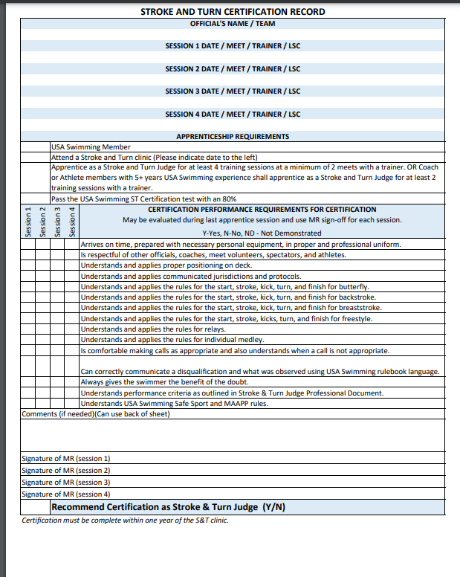
S&T Deck Mentoring
S&T Training Log
Official must demonstrate knowledge of the rules and the performance requirements.
Apprentice can choose to do additional sessions.
Email: Area Official’s chair, cc: OC, apprentice, MR
MR ensure that the email occurs.
An Action Plan is individualized based on the apprentices needs and provided within 2 weeks of submission of certification record to the Area Officials Chair.
Area Officials Chair may request more information from Trainers.
If someone is not progressing, it might make sense to give the AOC a heads up and thoughts on what would be helpful as an action plan for the Apprentice Official.

Slide 15
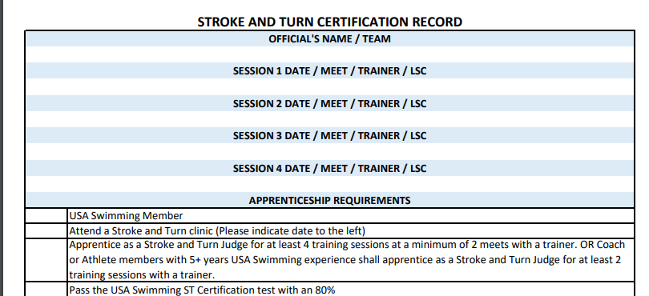
S&T Deck Mentoring

Slide 16
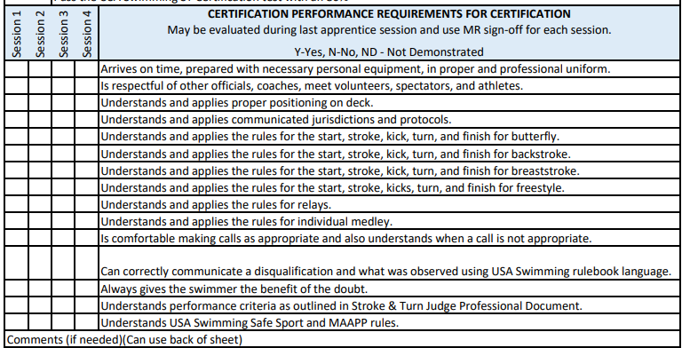
S&T Deck Mentoring
Each session is an evaluation as well as a training session
Y-Yes: Official is ready to be on deck without additional training sessions
It is OK for Trainees to do extra sessions. Work with Trainee on each session together to determine progression.

Slide 17
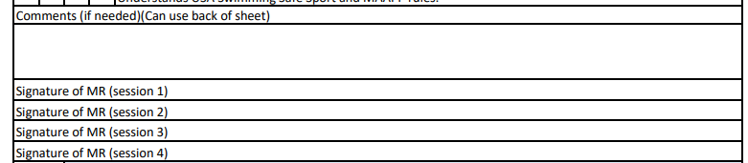
S&T Deck Mentoring
Print Name not signature

Slide 18
S&T Deck Mentoring – Best Practices
Oregon Reference Material - S&T Log
Relay exchanges every opportunity
Different Levels of Swimmers
A swimmers
B swimmers
C swimmers
Different age groups
10&U
11-14
13&O
Multiple different trainers
Multiple different pools
Apprentice read S&T rules before each session
Apprentice fill out DQ slips. Trainer prints their name.
Bottom line: Apprentice official must demonstrate knowledge even if they don’t have these experiences.

Slide 19
S&T Deck Mentoring – Before Session
Sit down with S&T trainee and understand
What would they like to focus on and get out of this session?
Any questions?
Assess together where the trainee is in their training progression.
Review training log
How would they like the training on deck to proceed.
Newer officials may want to have you describe the rules
More experienced trainees may want you to ask them questions and have them explain the rules.
The most experienced apprentice may just want to talk to you about the rules with no prompting
Who will be raising their hand.
“We’ve all been there”

Slide 20
S&T Deck Mentoring – During the Session
Newer trainee:
Break down the rules into small pieces and focus on only one piece at a time.
Describe what rule(s) you are thinking about as the swimmer approaches.
Describe what you observed
Protocol and position on deck
Experienced trainee:
Ask what rule(s) the trainee is thinking about as the swimmer approaches.
Gently insert additional considerations
Apprentice can raise hand but the mentor needs to see the violation. Apprentice officials can’t make calls.
Provide feedback to apprentice based on observations.
Most advanced (rarely):
Progressively have the trainee go through a stroke briefing with limited prompting.
Official should be able to complete the stroke briefing for all strokes and relays.
Likely only for recently experienced swimmers and coaches (2 session signoff)
All feedback should occur during the session to allow the apprentice official to work on developing the skill during the session.
Use Rulebook language

Slide 21
S&T – Feedback steps
Observe the behavior
Remember any concerns identified by the trainee
Describe you observation
Focus on the behavior and not the person
Be as clear and brief as possible
Avoid evaluative, judgmental statements
Provide positive reinforcement
Set the tone for the dialog, not a monolog
Don’t overload the trainee with constant feedback

Slide 22
S&T Deck Mentoring – After the Session
Ask the apprentice official their thoughts on the session.
Ask deeper questions for understanding (not leading) if needed.
Apprentice will likely remember the areas that they did well and where they need to focus next time. If so, you have done a great job.
May need to gently add in either areas that the apprentice did really well but didn’t remember or other areas that were discussed.
Fill in the checklist honestly and provide reasons for your answers so that the apprentice can learn from the experience or engage in dialog on areas that they perceived differently than you for each of you to gain a better understanding.
Review with the meet referee and have them print their name.
All sessions need to be entered into OTS by Meet Referee.

Slide 23
Starter – Pre-requisites
Member of USA Swimming.
Starter Certification course
Certified Stroke & Turn Judge for minimum of three (3) months; worked at least four (4) Sessions at a minimum of two (2) meets since Stroke & Turn certification.
Pass USA Swimming Starter certification test (>=80%).

Slide 24
Starter - Requirements
Apprentice as Starter for at least four (4) Training Sessions total, over two (2) meets with two (2) Trainers.
Trainer can be the Deck Referee.
Satisfactory Performance

Slide 25
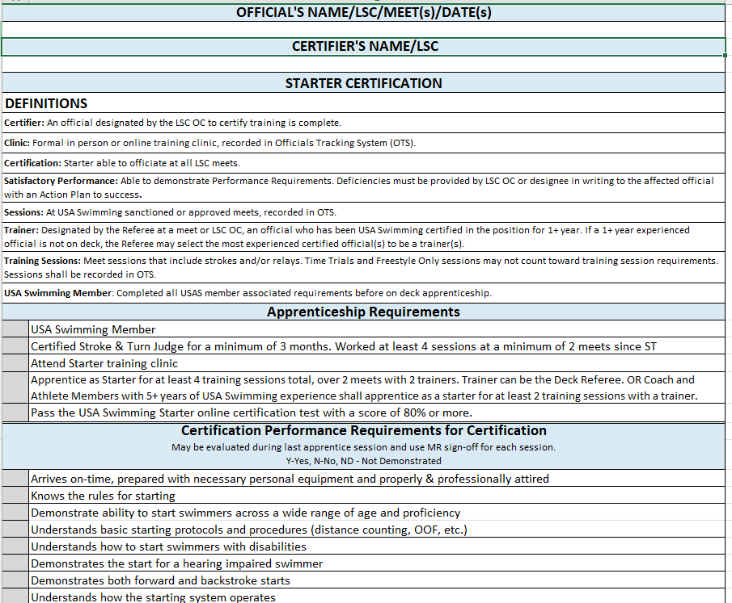
Starter
Training Log
Starter Professional Document
Official must demonstrate knowledge of the rules and the performance requirements.
Apprentice can choose to do additional sessions.
Email.
An Action Plan is individualized based on the apprentices needs and provided within 2 weeks of submission of certification record to the Area Officials Chair.
Area Officials Chair may request more information from Trainers.
If someone is not progressing, it might make sense to give the AOC a heads up and thoughts on what would be helpful as an action plan for the Apprentice Official.

Slide 26
Starter – Before the Session
See S&T for mentoring before, during and after the session
Setup Equipment
Check timing equipment with ET
Timer Briefing

Slide 27
Timer Briefing
Thank you for your assistance with Timing
Please be aware of the applicable MAAPP requirements – They are specific to this meet.
This meet is conducted according to current USA Swimming Rules, including the Minor Athlete Abuse Prevention Policy.
Make sure all interactions with athletes are observable and interruptible.
Deck changing is prohibited. Report instances of deck changing to the meet referee/meet director.
There is a separate locker room/restroom for athletes and all other adults. Make sure that you are only using the facility marked for you
Do not text or use cell phone while behind the blocks
If needed, ask the swimmer their name to verify the correct swimmer is in the lane.
Before the race begins:
Check to see if swimmer is present
Clear the Stopwatch
When the light on the starter box flashes, START your watch
While swimmer is in the water:
Check the watch to make sure it is running. If there is a malfunction WAVE the watch in the air to get a replacement from the head timer.
As the swimmer approaches the finish, stand directly over the finish wall to observe the touch, at that touch stop the watch.
If your athlete is the last to finish, you may need to remember the times, clear the watch and begin again.
After the finish:
Record the watch times
Get ready for the next heat. If your athlete is the last to finish, please remember the times and write them down after the next heat is in the water

Slide 28
Starter – During the session
Voice control
False starts
Order of Finish – once feel comfortable with the above.

Slide 29
Starter – Best Practices
Oregon Swimming reference – training log
Progression
Equipment setup and testing, Timer Briefing
Voice Control
False starts
Work with starter as they feel comfortable to move towards fully owning the starting position
Experiences
Different pools
12&U, 13&O
ABC, BC
Bottom line: Apprentice Starter must demonstrate knowledge even if they don’t have these experiences.

Slide 30
Deck Referee – Pre-requisites
Member of USA Swimming.
Certified Stroke & Turn.
Certified Administrative Official.
Certified Starter.
Attend Referee Clinic training.
Online April 1, 2025
Pass USA Swimming Referee certification test.

Slide 31
Deck Referee - Requirements
Apprentice as a Referee for at least four (4) Training Sessions total over two (2) meets with two (2) Trainers.
Satisfactory Performance

Slide 32
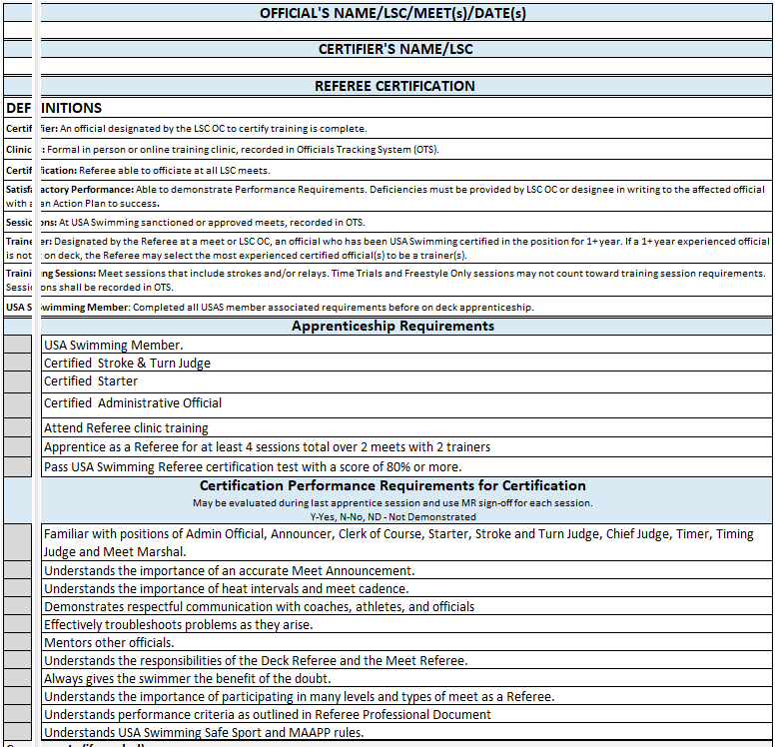
Deck Referee
Training Log
DR Professional Document
Apprentice can choose to do extra sessions.
Email
Official must demonstrate knowledge of the rules and the performance requirements.
Bottom line: Apprentice Starter must demonstrate knowledge even if they don’t have these experiences.

Slide 33
Deck Referee – Best Practices
Oregon Training Reference – DR training log
Experiences
DQ slip processing – ABC or BC meet and 12&U events
Whistle starts
Whistle starts with DQ processing
Other experiences
Multiple pools and multiple mentors. Seek out the most experienced referees.
Pre-meet safety check, etc.
Official’s briefing – recommend for each training session
Jurisdiction
Deck Rotation
Coaches meeting – attend and maybe last session present
Pre-meet email exchanges
Meet Announcement review including sanction requirements (rule 202.4.11)
Sanction requirements (rule 202.4)
CJ experience(s)
OTS entry
Running your own meet

Slide 34
Administrative Official – pre-requisites
Setup a separate USA swimming account for Officiating
USAS non-athlete registration (request unique registration link from your club)
Use legal name to help keep background check on track.
Choose official
Pay membership and select official
Complete the Foundations of Officiating and AO online clinic
Pass AO test (>=80%)
Complete a Level 2 Background Check
Complete Athlete Protection Training
Complete Concussion Protocol Training
Recommended apprentice to email Meet Referee ahead of meet.
Instructions on setting up a separate USA Swimming Account
Will say it is an unsafe link.

Slide 35
Administrative official - requirements
Apprentice as an Administrative Official for at least four (4) Training Sessions over two (2) meets with a Trainer(s).
Satisfactory Performance.

Slide 36
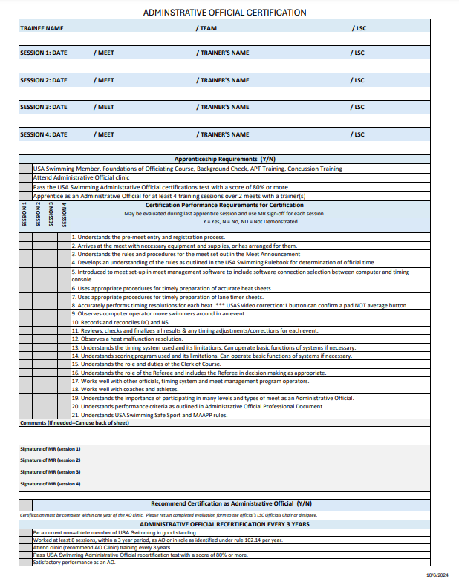
Administrative Official
Training Log
AO Professional document
Apprentice can choose to do extra sessions.
Email to document
Official must demonstrate knowledge of the rules and the performance requirements.

Slide 37
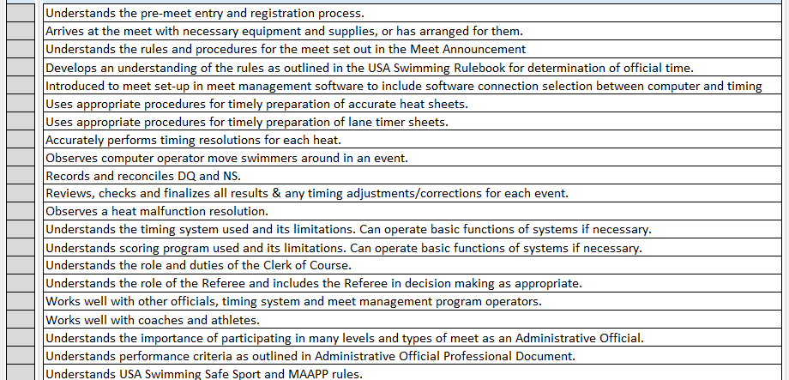
Administrative Official
Companion checklist – Anne Stansell

Slide 38
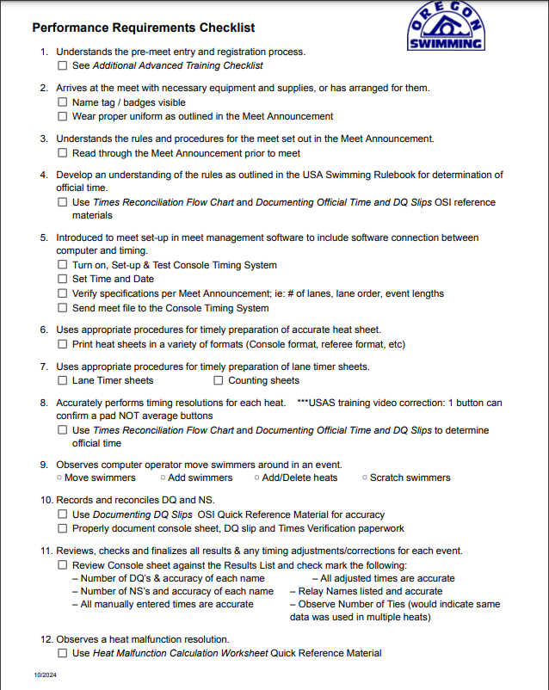
AO – Companion Checklist

Slide 39
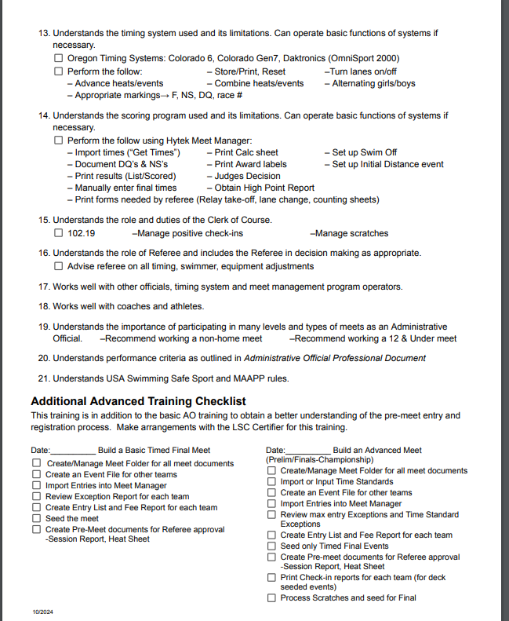
AO – Companion Checklist

